Slide 1
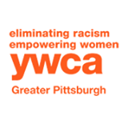
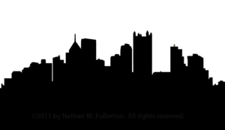
Pittsburgh for CEDAW*
Our Mission is to have Pittsburgh become a CEDAW City by passing an ordinance that establishes the frame- work and reflects the principles of CEDAW (The UN Convention on the Elimination of All Forms of Discrimination Against Women).Then, to leverage that ordinance to improve the lives of women and girls in Pittsburgh.
CEDAW is an international agreement that affirms the principles of fundamental human rights and equality for women around the world and to ensure equality for women and girls in the civil, political, economic, social and cultural arenas.
To date, 187 out of 193 United Nations member states have ratified CEDAW. The United States is one of only six countries — along with Iran, Sudan, Somalia, Palau and Tonga — that have not ratified CEDAW.
The Cities for CEDAW campaign “Makes the Global Local” by implementing the Convention in cities and towns across the United States. Four cities and Miami/Dade County have already passed ordinances, thirty other cities are in-process. We believe that the time is right for Pittsburgh to participate .
* Pittsburgh for CEDAW is a project of the
Thomas Merton Center
PITTSBURGH for CEDAW is
ENDORSED BY
32 BJ SEIU
AAUW of Fox Chapel
AAUW of North Hills Pgh
ACLU of PA
American Friends Service Committee PA
B-PEP
Code Pink
F & M Technology LLC
Gender Studies Class at Slippery Rock University
Gertrude Stein Club of Greater Pittsburgh
Greater Pittsburgh Business & Professional Women's Club
Health Care 4 All PA
Human Rights City Alliance
League of Women Voters of Greater Pittsburgh
New Voices Pittsburgh
One Pittsburgh
Pittsburgh Chapter of WORD
Pittsburgh United
Planned Parenthood of Western PA
The Commission on Human Relations
Thomas Merton Center
University of Pittsburgh Dept of Gender Studies
Women and Girls Foundation
Women's International League for Peace and Freedom
Women's Institute Chatham University
Women's Law Project
YWCA Greater Pittsburgh
Zonta Club of Pittsburgh
No Limits
For Women!
The 2014 US Conference of Mayors voted to support the
Cities for CEDAW Campaign
PITTSBURGH FOR CEDAW
In 2011 Pittsburgh Became the 5th
Human Rights City in the US.
Help us make Pittsburgh a CEDAW City
Pittsburgh for CEDAW Coalition
Convention on the Elimination of All Forms of Discrimination Against Women
It pays to invest in women!
Economists at the World Bank have concluded that improving gender equality improves the overall economy while increasing school enrollment, improving children’s health, and reducing maternal and infant mortality.
Email: pgh4CEDAW@gmail.com to join our coalition, provide input, or more information
: Cities for CEDAW Pittsburgh
Website: pgh4CEDAW.org

Slide 2
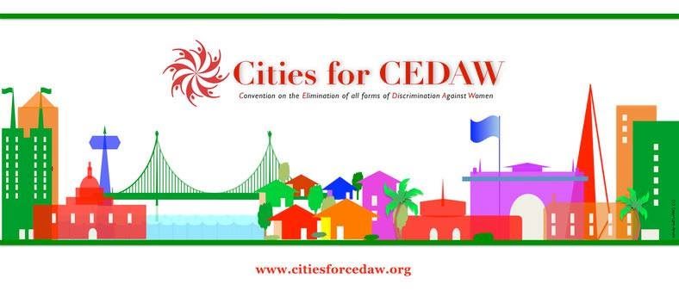
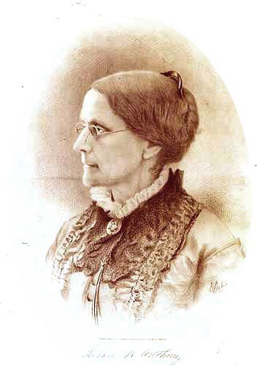
Women's Rights are Human Rights
Is there Discrimination in Pittsburgh?
In the United States
1 in 3 women will become victims of domestic violence.
1 in 3 teenage girls will be physically assaulted by a boyfriend
1 in 5 women have or will experience a completed and/or attempted rape during their college career.
Women face higher eviction rates than men due to lower wages, child-rearing responsibilities, and other issues.
What can a CEDAW City look like?
San Francisco, becoming a CEDAW City resulted in:
Violence Against Women Prevention and Intervention Grants Program
44 Months Without Domestic Violence Homicide
Public Works placed greater street lighting for better safety.
Department of Juvenile Probation Created a “girls unit” providing gender-specific, trauma-focused services for girls.
Increase in female employment in professional jobs within the city of San Francisco.
Gender Equality Principles Initiative to expand gender analysis.
In Pennsylvania
60% of PA minimum wage earners are women
Cost of Infant Care in PA 27% of Women's Median Annual Earnings
Black girls are suspended from school at higher rates (13%) than girls of any other race or ethnicity and most boys.
Only 17% of Pennsylvania State law makers are women.
Poverty Rates in Pennsylvania
Women: 13.4%
Female-Headed Families: 39.7%
Black Women: 28.0%
Hispanic Women: 31.6%
Asian Women: 15.5%
Native American Women: 34%
Women 65 & Older: 9.5%
Children: 19.4%
National Women’s Law Center
In Pittsburgh
71% of Pittsburgh Families living in poverty are headed by Single Mothers
White Women in the Pittsburgh Area are paid 73 cents, African American women 64 cents, and Latinas just 55 cents for every dollar paid to white, non-Hispanic men.
About 4000 protection from abuse orders are issued annually in Allegheny County.
Well over 6000 women sought help in Women’s shelters in Greater Pittsburgh last year
“There never will be complete equality until women themselves help
to make laws and elect lawmakers.”
Susan B. Anthony
We Can Do Better!

